Slide 1
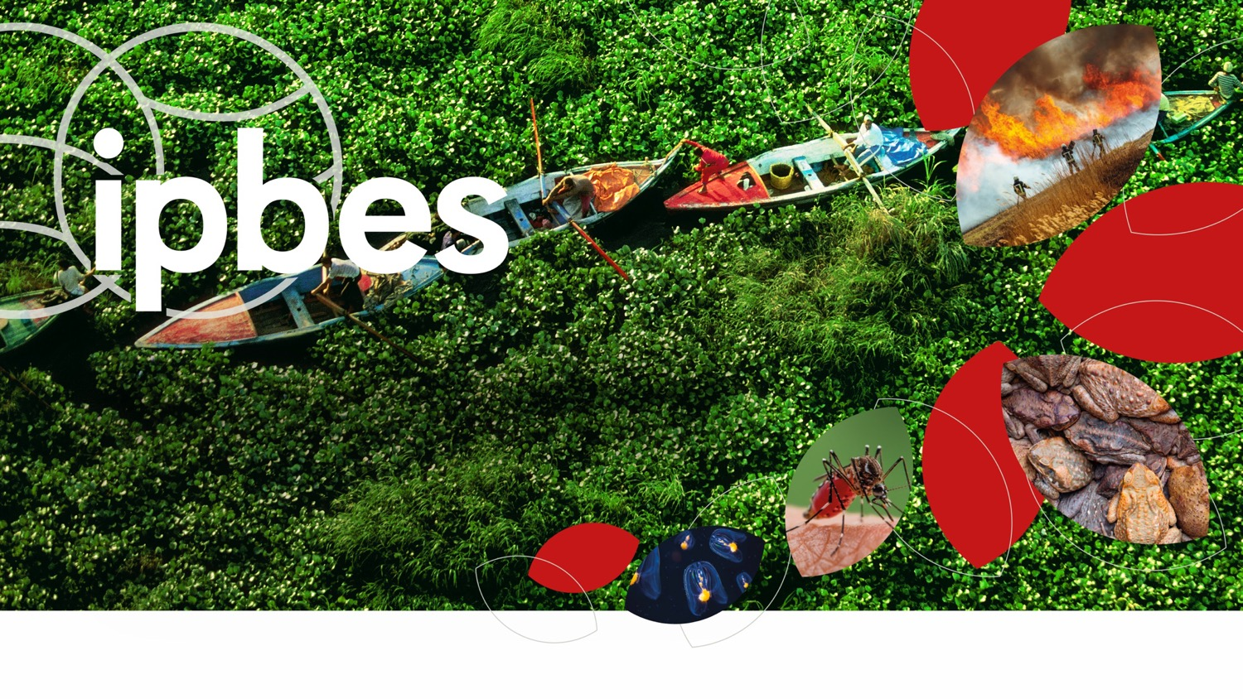

Assessment Report on Invasive
Alien Species and their Control
www.ipbes.net
The Intergovernmental Science-Policy Platform
on Biodiversity & Ecosystem Services
#InvasiveAlienSpecies Assessment

Slide 2


What are invasive alien species?
1.

Slide 3

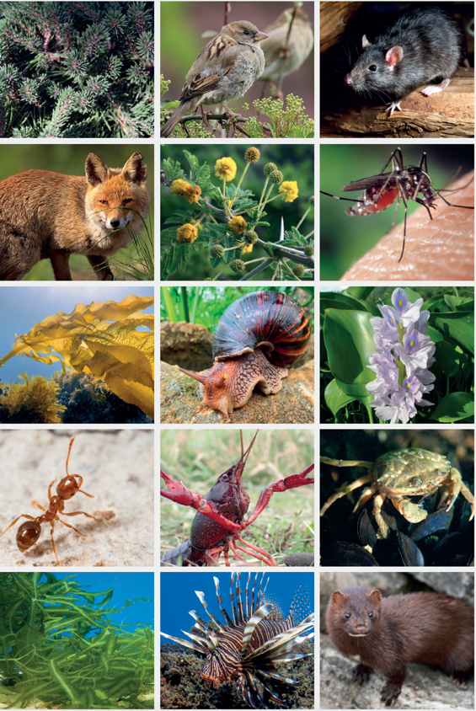
Invasive alien species are one of the 5 major drivers of biodiversity loss
Alien species are animals, plants, and other organisms that have been introduced by human activities to new regions
Invasive alien species are a subset of alien species, known to have established and spread with negative impacts on nature. Many invasive alien species also have impacts on people
#InvasiveAlienSpecies Assessment

Slide 4
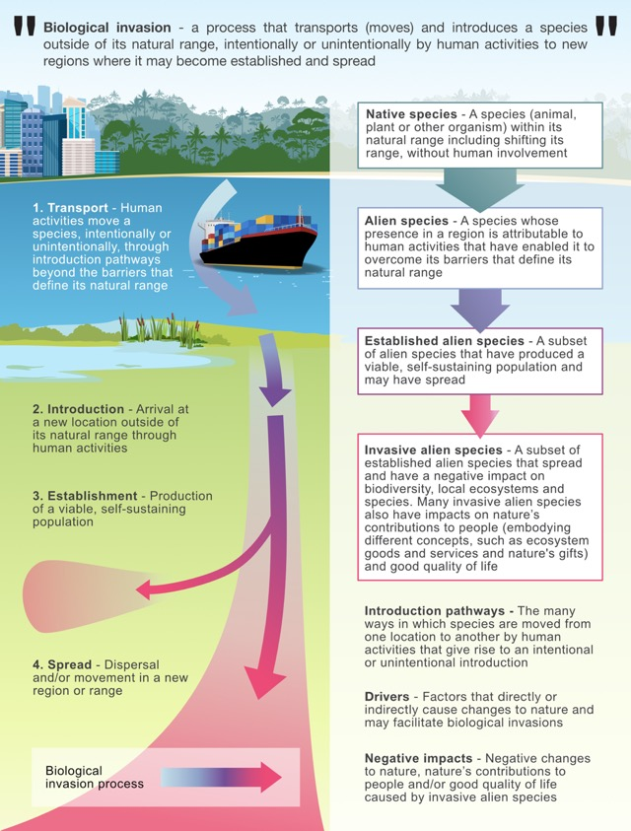
“Biological invasions” is a term used to describe the process involving the intentional or unintentional transport or movement of a species outside its natural range by human activities and its introduction to new regions, where it may become established and spread.
#InvasiveAlienSpecies Assessment

Slide 5
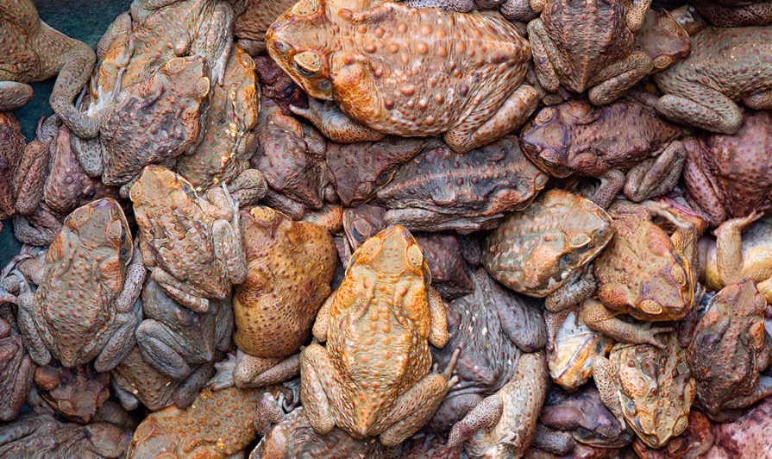
Findings of the report
2.

Slide 6

People and nature are threatened by invasive alien species in all regions of Earth
37,000 established alien species have been introduced by human activities worldwide
200 new alien species every year
3,500 invasive alien species, with negative impacts on nature, and also, in some cases, on people
1,061 alien plants (6 per cent of all established alien plants), 1,852 alien invertebrates (22 per cent), 461 alien vertebrates (14 per cent) and 141 alien microbes (11 per cent) are known to be invasive globally
#InvasiveAlienSpecies Assessment

Slide 7
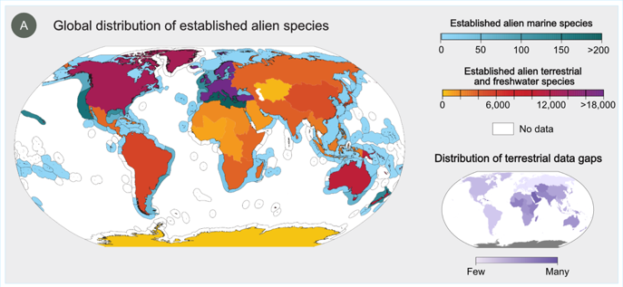
Invasive alien species are a global threat
Impacts from invasive alien species are reported in the Americas (34%), Europe and Central Asia (31%) and Asia-Pacific (25%), with fewer reported in Africa (7%)
Some areas, despite being protected for nature conservation or being remote, are also vulnerable to the negative impacts of invasive alien species.
75% of negative impacts are reported from the terrestrial realm, especially temperate and boreal forests and woodlands and cultivated areas
14% from the freshwater realm, especially from inland surface waters/waterbodies
10% from the marine realm, especially from shelf ecosystems
#InvasiveAlienSpecies Assessment

Slide 8
Invasive alien species cause dramatic and, in some cases, irreversible changes to nature across all regions of Earth
60% of global extinctions have been caused, solely or alongside other drivers, by invasive alien species
16% of global extinctions have been caused solely by invasive alien species
1,215 documented local extinctions of native species have been caused by invasive alien species
85% of documented impacts on nature are negative
#InvasiveAlienSpecies Assessment

Slide 9
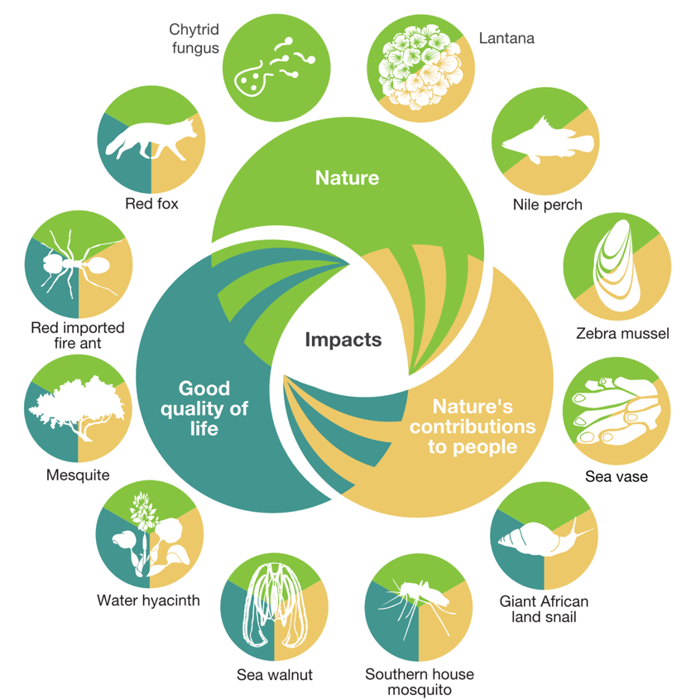
Impacts of invasive alien species are varied
In addition to their impacts on nature, about 16% of invasive alien species have negative impacts on nature’s contributions to people, and about 7% on good quality of life.
#InvasiveAlienSpecies Assessment

Slide 10
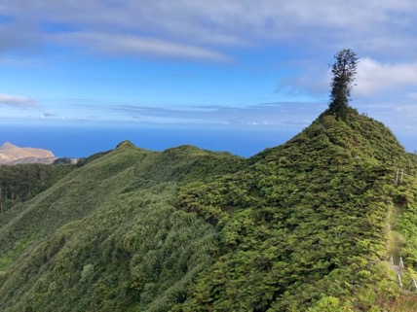
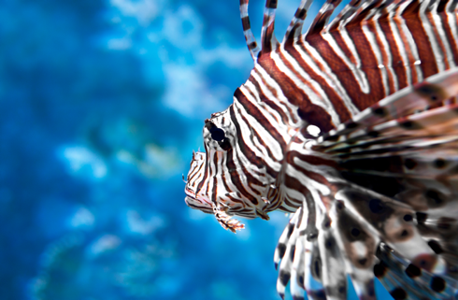
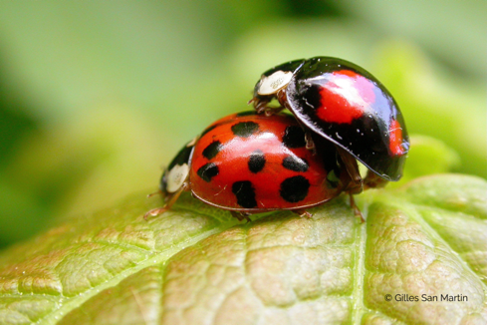
What are the mechanisms of impacts on nature?
  Change ecosystems
  27%
  Predation and herbivory
  18% and 12%
  Compete with native species
  24%
And also through hybridization, transmission of disease, parasitism, poisoning/toxicity, bio-fouling or other direct physical disturbance, chemical, physical, structural impact on ecosystem and indirect impacts through interactions with other species
#InvasiveAlienSpecies Assessment

Slide 11
Invasive alien species are a major cause of biodiversity loss on islands
20% of all impacts are reported from islands
90 per cent of documented global extinctions with invasive alien species as one of the major causes are reported from islands
The number of alien plants exceeds the total number of native plants on more than one quarter of islands
Islands are also vulnerable to climate change, which can increase the rate of establishment and spread of many invasive alien species
#InvasiveAlienSpecies Assessment

Slide 12
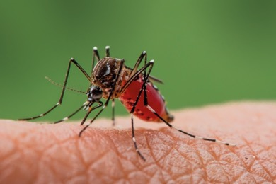
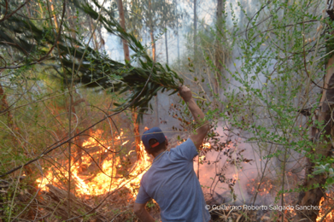
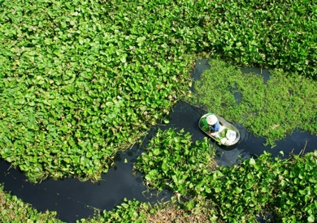
How do invasive alien species impact people?
Economies, food security, water security, human health and cultural identities are profoundly and negatively affected by invasive alien species
80% of documented impacts on nature’s contributions to people are negative, with food supply being by far the most frequently reported impact
In 2019, global annual costs of biological invasions were estimated to exceed $423 billion. 92 per cent accrue from the negative impact of invasive alien species on nature’s contributions to people or on good quality of life, while only 8 per cent is related to management expenditures of biological invasions.
#InvasiveAlienSpecies Assessment

Slide 13
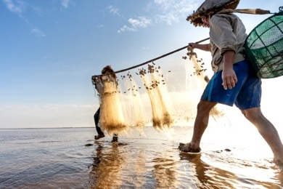

People with the greatest direct dependence on nature, including Indigenous Peoples and local communities, may be disproportionately affected by invasive alien species.
Invasive alien species can add to marginalization and inequity, including, in some contexts, gender- and age-differentiated impacts
More than 2,300 invasive alien species are found on lands of Indigenous Peoples across all regions of Earth
Invasive alien species negatively affect the autonomy, rights and cultural identities of Indigenous Peoples and local communities through the loss of traditional livelihoods and knowledge, reduced mobility and access to land, and increased labour to manage the invasive alien species
#InvasiveAlienSpecies Assessment

Slide 14
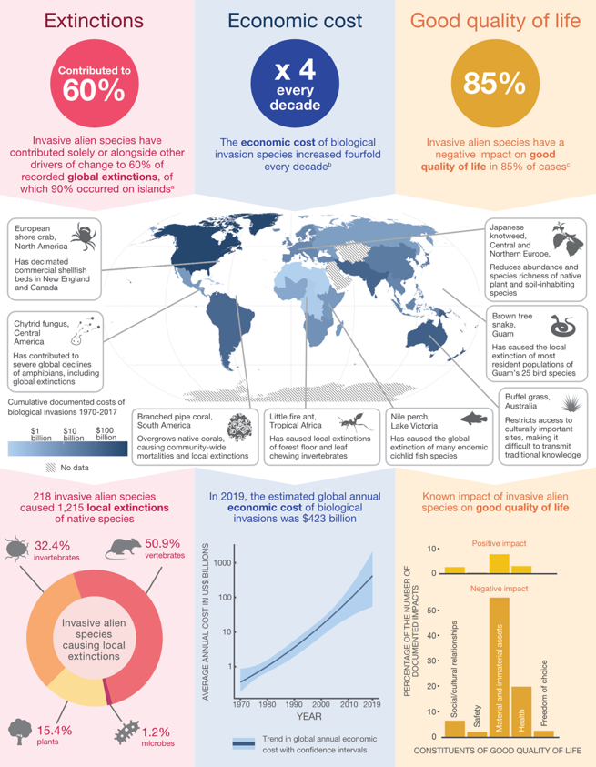
Extent of the problems caused by invasive alien species
Invasive alien species are a major driver of species extinctions, impose an economic burden and overwhelmingly undermine good quality of life
#InvasiveAlienSpecies Assessment

Slide 15

Current policies have been insufficient in managing biological invasions and preventing and controlling invasive alien species
Although most countries (80%) have targets for the management of biological invasions within their national biodiversity strategies and action plans
83% of countries do not have national legislation or regulations directed specifically toward the prevention and control of invasive alien species.
Nearly half of all countries (45%) do not invest in management of invasive alien species
#InvasiveAlienSpecies Assessment

Slide 16
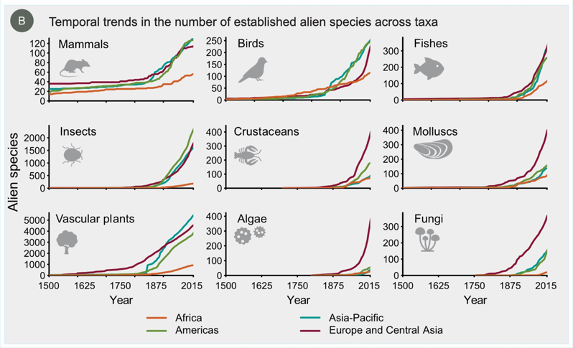
The threats from invasive alien species are increasing significantly in every region and across all taxa
37% of all known alien species have been reported since 1970
The number of alien species has been rising continuously for centuries in all regions and is expected to continue increasing in the future
#InvasiveAlienSpecies Assessment

Slide 17

People at the heart of the problem…
Many human activities facilitate the transport, introduction, establishment and spread of invasive alien species
If things remain unchanged, by 2050 the total number of alien species globally is expected to be about 36% higher than in 2005.
#InvasiveAlienSpecies Assessment

Slide 18



Economic activities, particularly global trade, increasingly facilitate the transport and introduction of invasive alien species
There is a strong link between the volume of commodity imports and the number of invasive alien species in a region, and patterns in the global spread of species mirror shipping and air traffic networks
Biosecurity measures at international borders have not kept pace with the growing volume, diversity and origins of global trade and travel
Projected growth in international trade and movement of people, including tourism, will lead to further pressure on border inspection regimes and could soon overwhelm the biosecurity capability of most countries
#InvasiveAlienSpecies Assessment

Slide 19
Land- and sea-use change and climate change increasingly facilitate the establishment and spread of invasive alien species
Land- and sea-use changes may increase the vulnerability of natural ecosystems and alter processes that cause natural disturbance of landscapes (e.g., wildfires)
Transportation and utility infrastructures can create corridors that facilitate the spread of invasive alien species
Marine and aquatic infrastructure may alter seascapes and the functioning of marine ecosystems, facilitating the spread of invasive alien species
Climate change, along with the continued intensification and expansion of land-use change may lead to future increases in the establishment and spread of invasive alien species in disturbed habitats and in nearby natural habitats
#InvasiveAlienSpecies Assessment

Slide 20
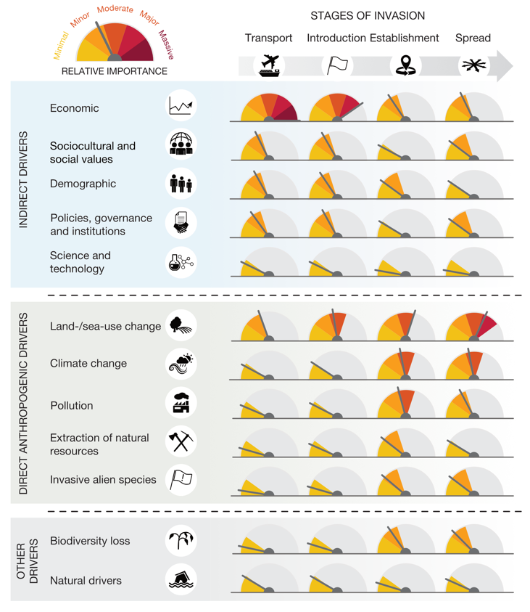
Across all biomes, the relative importance of drivers in facilitating biological invasions varies across stages of the biological invasion process
#InvasiveAlienSpecies Assessment

Slide 21
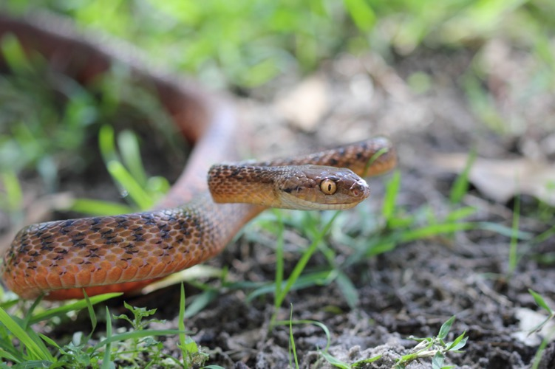
The ongoing amplification of drivers of change in nature may substantially increase the number of invasive alien species and their impacts in the future
Other drivers of change such demographic, economic, and land- and sea-use change are increasing and can amplify the threats and impacts of invasive alien species
Climate change will also be a major cause of future increases in the risk of invasive alien species
#InvasiveAlienSpecies Assessment

Slide 22
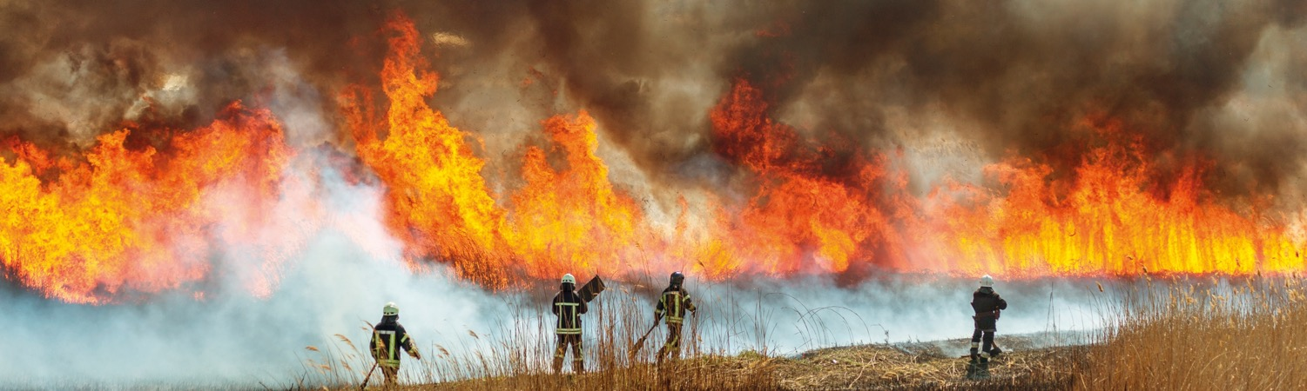
The magnitude of the future threat from invasive alien species is difficult to predict because of complex interactions and feedback among direct and indirect drivers of change in nature
Climate change interacting with land- and sea-use change is predicted to profoundly shape and amplify the future threat from invasive alien species
Variations in human perceptions and values add yet another level of complexity, as sociocultural drivers interact with other indirect drivers and influence direct drivers
#InvasiveAlienSpecies Assessment

Slide 23
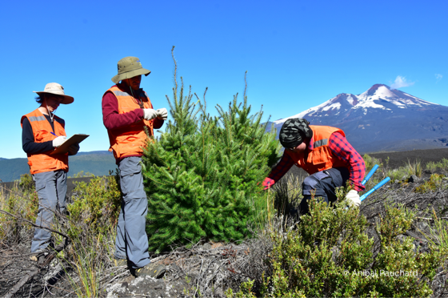
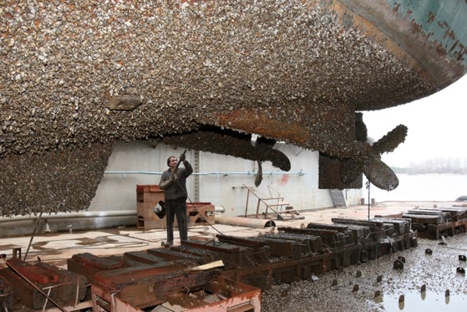
… People at the heart of the solution
Biological invasions and their adverse impacts can be prevented and mitigated through effective management
There are 3 management options:
management of pathways of introduction and spread of invasive alien species;
management of target invasive alien species at either local or landscape scales; and
site-based or ecosystem-based management.
#InvasiveAlienSpecies Assessment

Slide 24
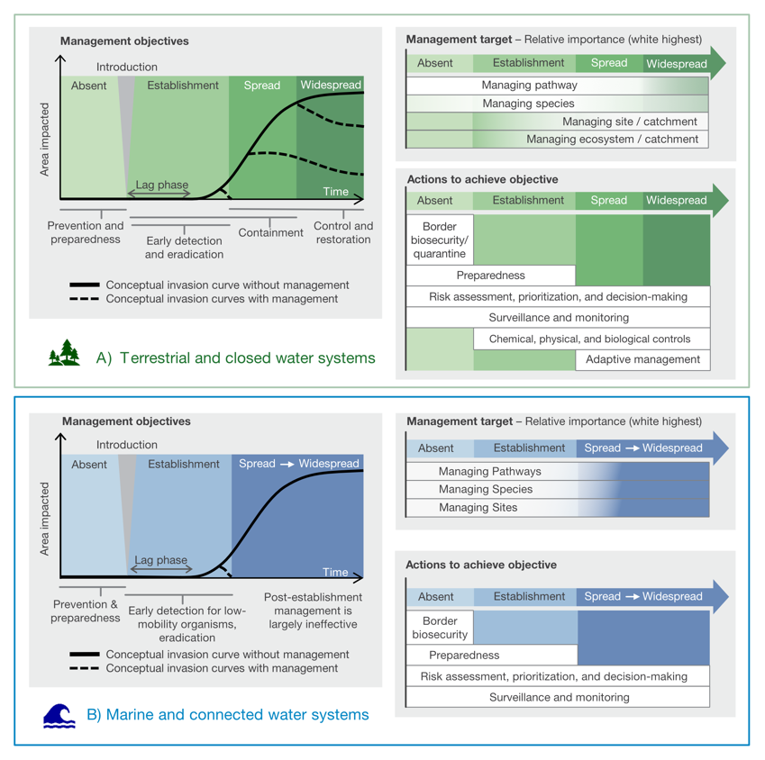
Conceptual diagram of management-invasion continuum
#InvasiveAlienSpecies Assessment

Slide 25
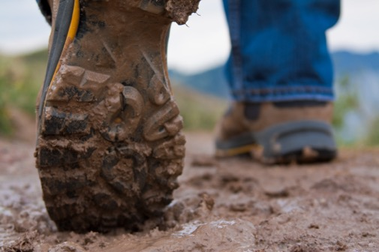
Prevention and preparedness are the most cost-effective options
Prevention can be achieved through pathway management, including strictly enforced import controls, pre-border, border and post-border biosecurity, and measures to address escape from confinement.
Prevention is particularly important on islands, and it is also critical in marine and connected water systems, where most attempts at eradicating or containing invasive alien species have mostly failed.
Sustained and adequate funding, capacity building, technical and scientific cooperation and transfer of technology, monitoring, quarantine and inspection facilities are necessary for effective prevention measures.
#InvasiveAlienSpecies Assessment

Slide 26
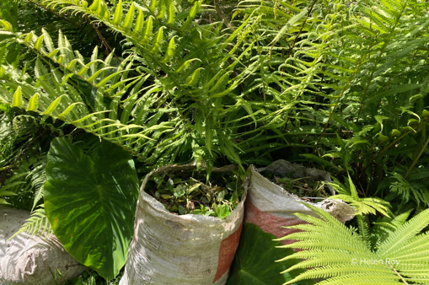
Prevention and preparedness are the most cost-effective options
Eradication has been successful, especially for small and slow-spreading populations of invasive alien species, especially in isolated ecosystems
Containment and control can be an effective option for invasive alien species that cannot be eradicated for various reasons in terrestrial and closed water systems, but most attempts in marine and connected water systems have been largely ineffective
The recovery of ecosystem functions and nature’s contributions to people can be achieved through adaptive management, including ecosystem restoration in terrestrial and closed water systems
#InvasiveAlienSpecies Assessment

Slide 27
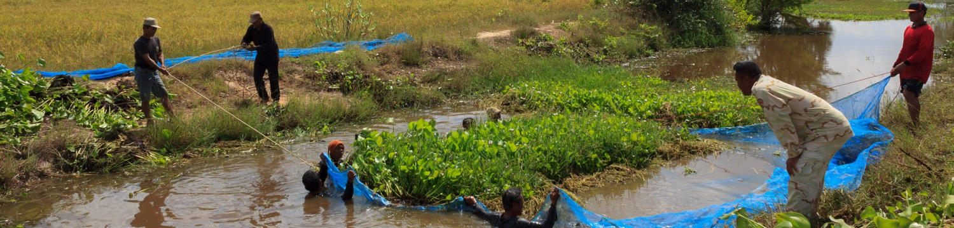
Engagement and collaboration with stakeholders and Indigenous Peoples and local communities improves outcomes of management actions for biological invasions, particularly where there are conflicting perceptions of the value of invasive alien species and the ethics of management options
Management actions also benefit from sharing and collaboration across knowledge systems
#InvasiveAlienSpecies Assessment

Slide 28
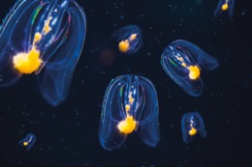
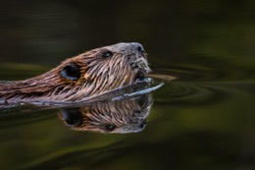
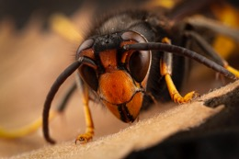
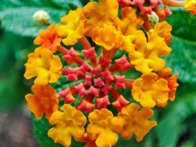
In December 2022, Governments adopted the Kunming-Montreal Global Biodiversity Framework and agreed to:
“Eliminate, minimize, reduce and or mitigate the impacts of invasive alien species on biodiversity and ecosystem services by identifying and managing pathways of the introduction of alien species, preventing the introduction and establishment of priority invasive alien species, reducing the rates of introduction and establishment of other known or potential invasive alien species by at least 50 per cent by 2030, and eradicating or controlling invasive alien species, especially in priority sites, such as islands” Target 6.
The Kunming-Montreal Global Biodiversity Framework provides an opportunity for national governments to develop or update aspirational, ambitious and realistic approaches to prevent and control invasive alien species
#InvasiveAlienSpecies Assessment

Slide 29
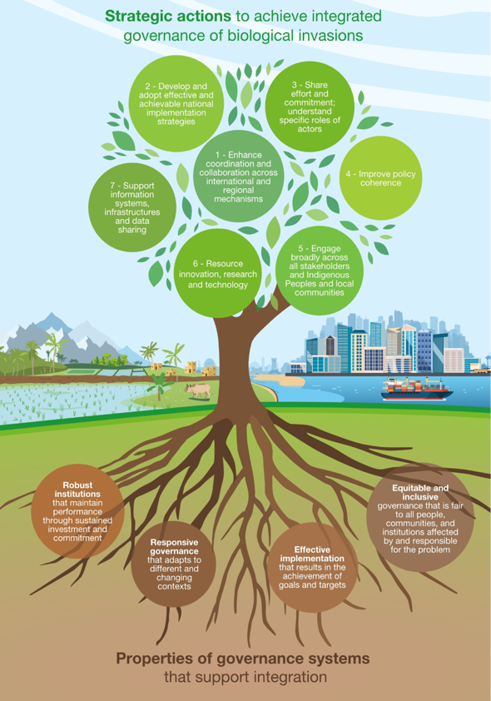
Ambitious progress in biological invasion management can be achieved with integrated governance
Strategic actions to prevent introduction and impact of invasive alien species include
Enhancing coordination and collaboration across international and regional mechanisms;
Developing and adopting effective and achievable national strategies;
Sharing efforts and commitment and understanding the specific role of all actors;
Improving policy coherence;
Broad engagement across all stakeholders and Indigenous Peoples and local communities;
Resourcing innovation, research and technology; and
Supporting information systems, infrastructures and data sharing.
#InvasiveAlienSpecies Assessment

Slide 30


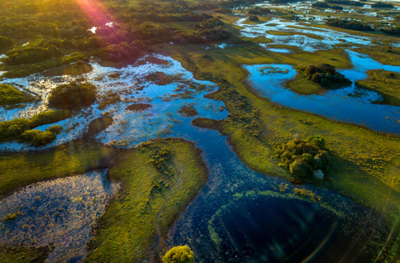
Preventing and controlling invasive alien species can strengthen the effectiveness of policies designed to respond to other threats to biodiversity and contribute to achieving several Sustainable Development Goals
such as marine biodiversity (Goal 14) and terrestrial biodiversity (Goal 15), food security (Goal 2), sustainable economic growth (Goal 8) and sustainable cities (Goal 11), as well as climate change (Goal 13) and health and wellbeing (Goal 3).
#InvasiveAlienSpecies Assessment

Slide 31
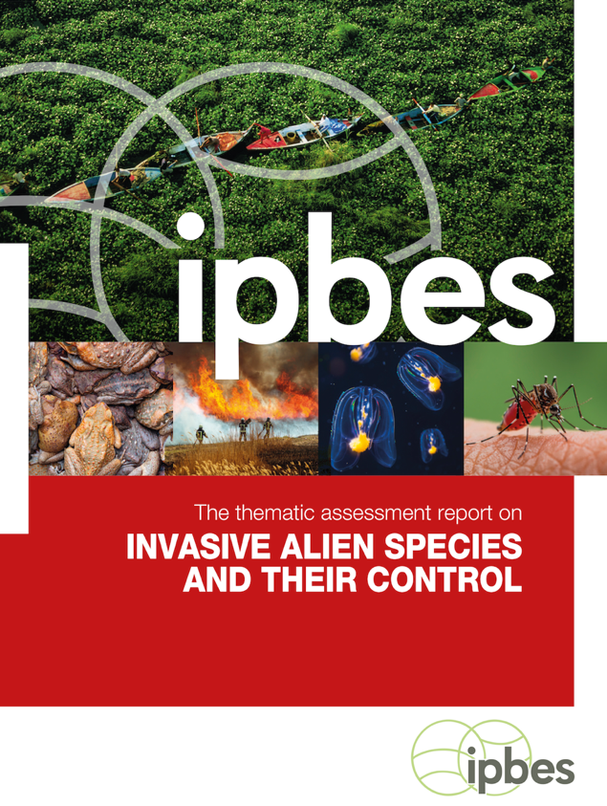
There is compelling evidence for immediate and sustained action
With sufficient resources and long-term commitment, preventing and controlling invasive alien species are attainable goals that will yield significant long-term benefits for people and nature.
#InvasiveAlienSpecies Assessment

Slide 32
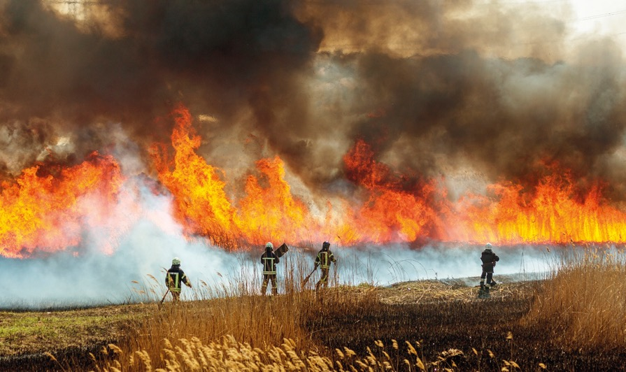
Expected impacts of the Report
3.

Slide 33
The invasive alien species Assessment is the first comprehensive global report on invasive alien species and their control
It provides the best-available evidence, critical analysis and options for governments, civil society, Indigenous Peoples and local communities, the private sector and all those seeking to address the issue of biological invasions
#InvasiveAlienSpecies Assessment

Slide 34
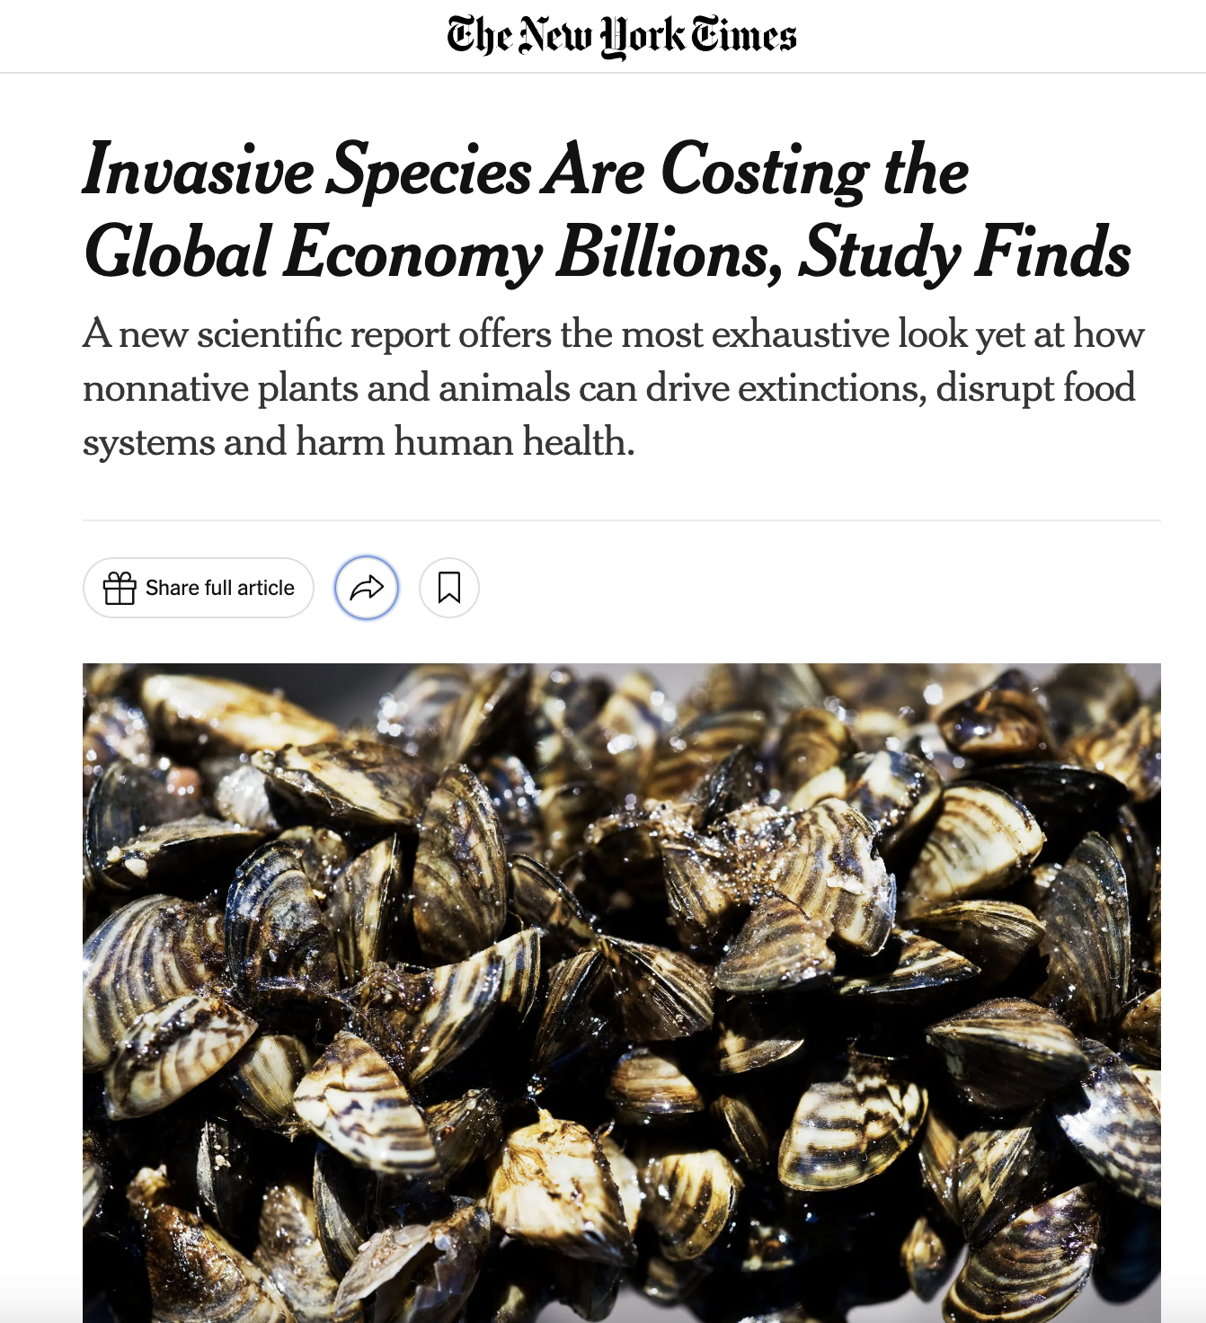
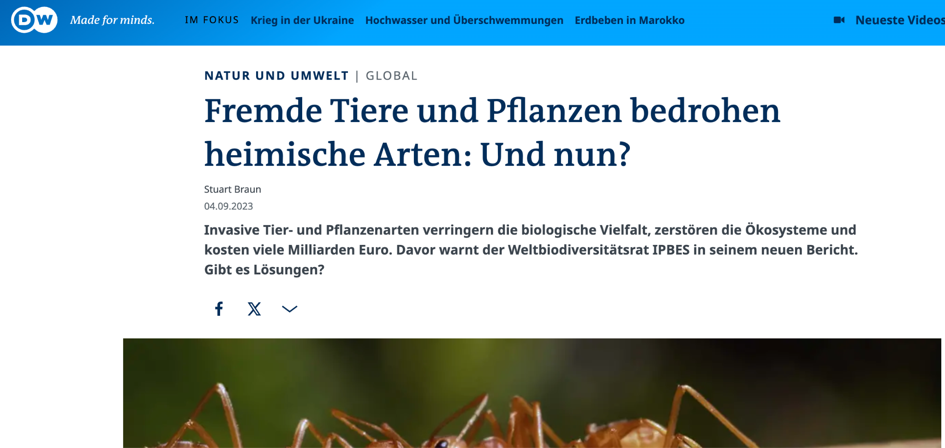
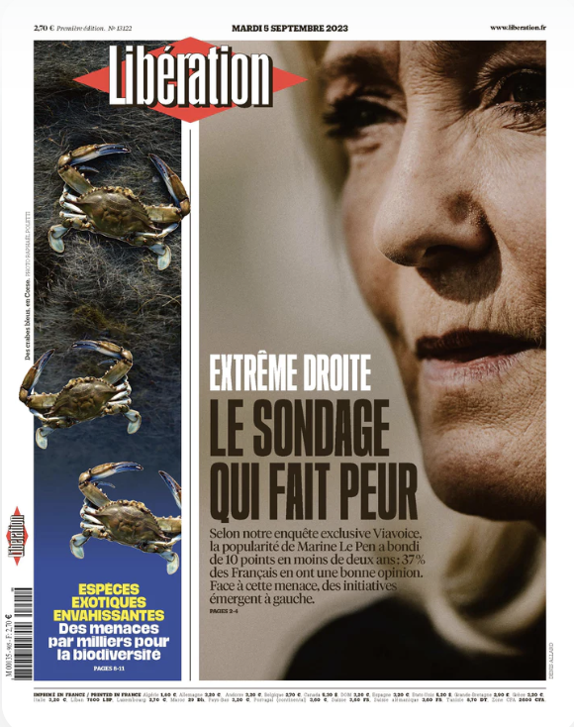
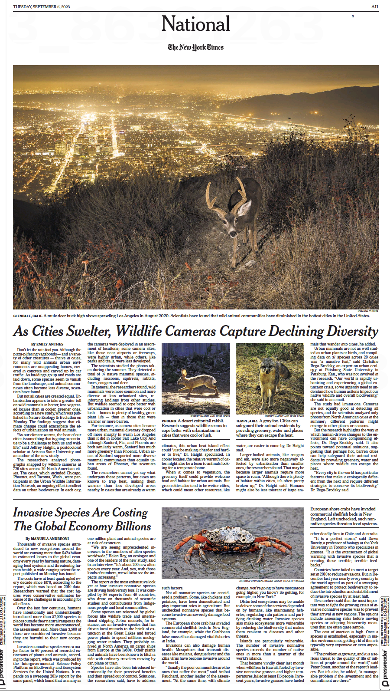
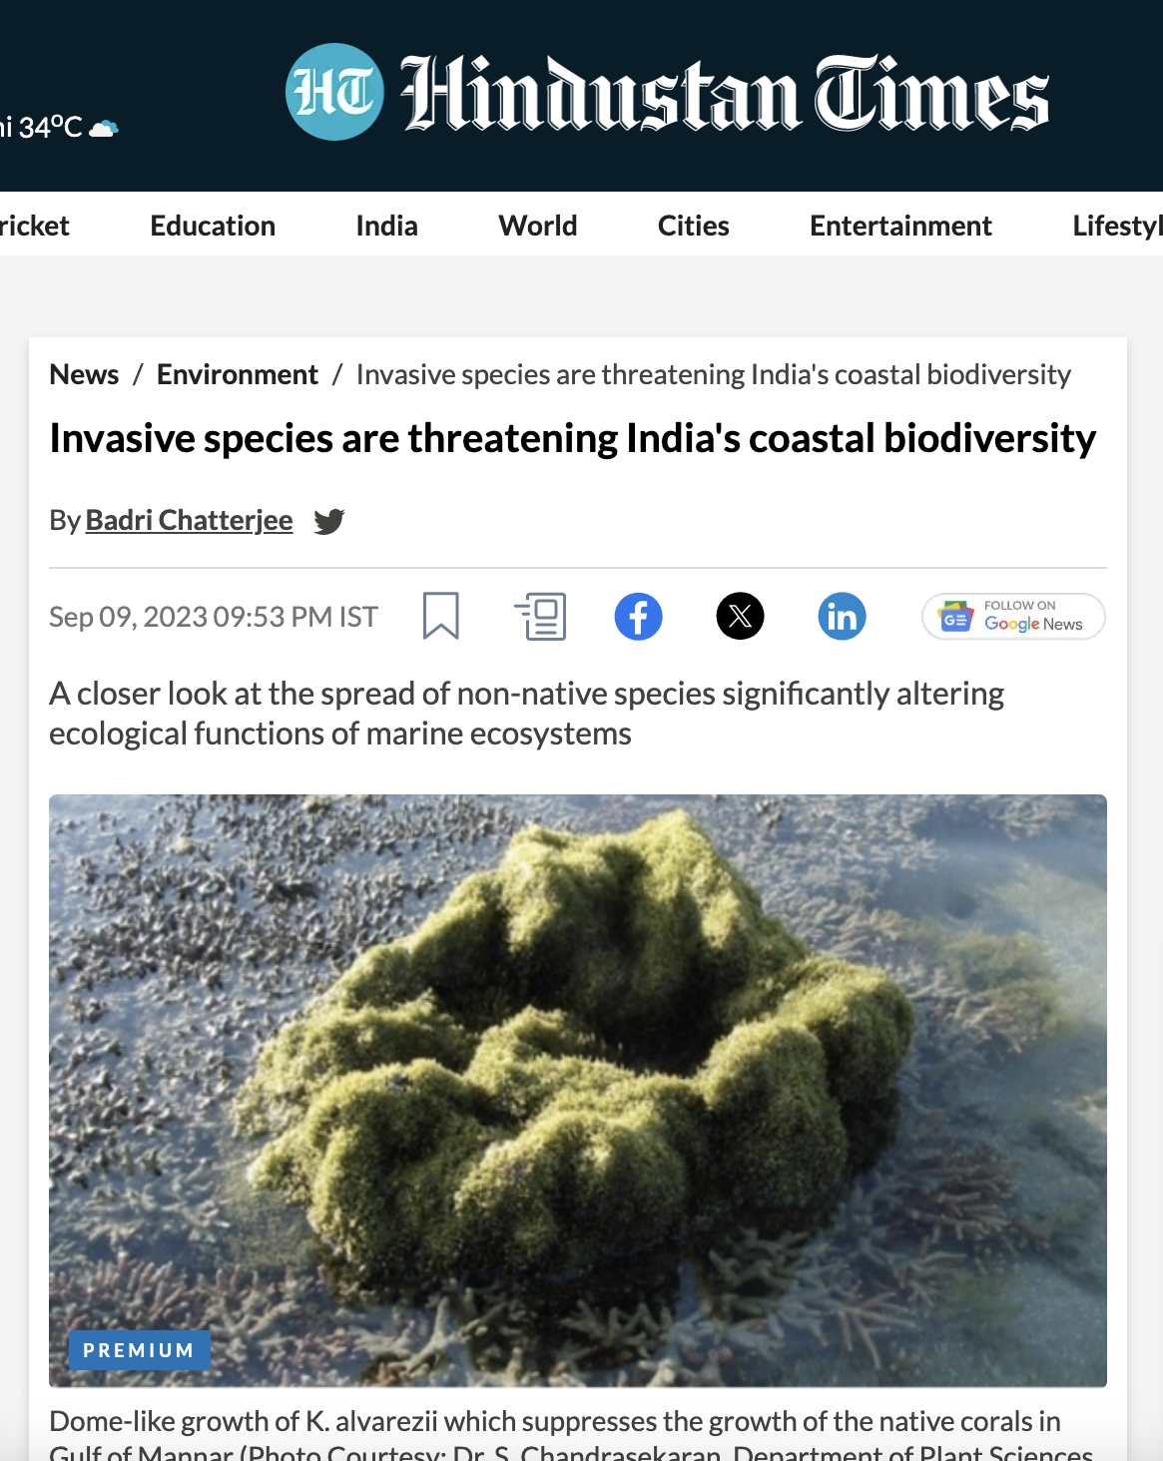
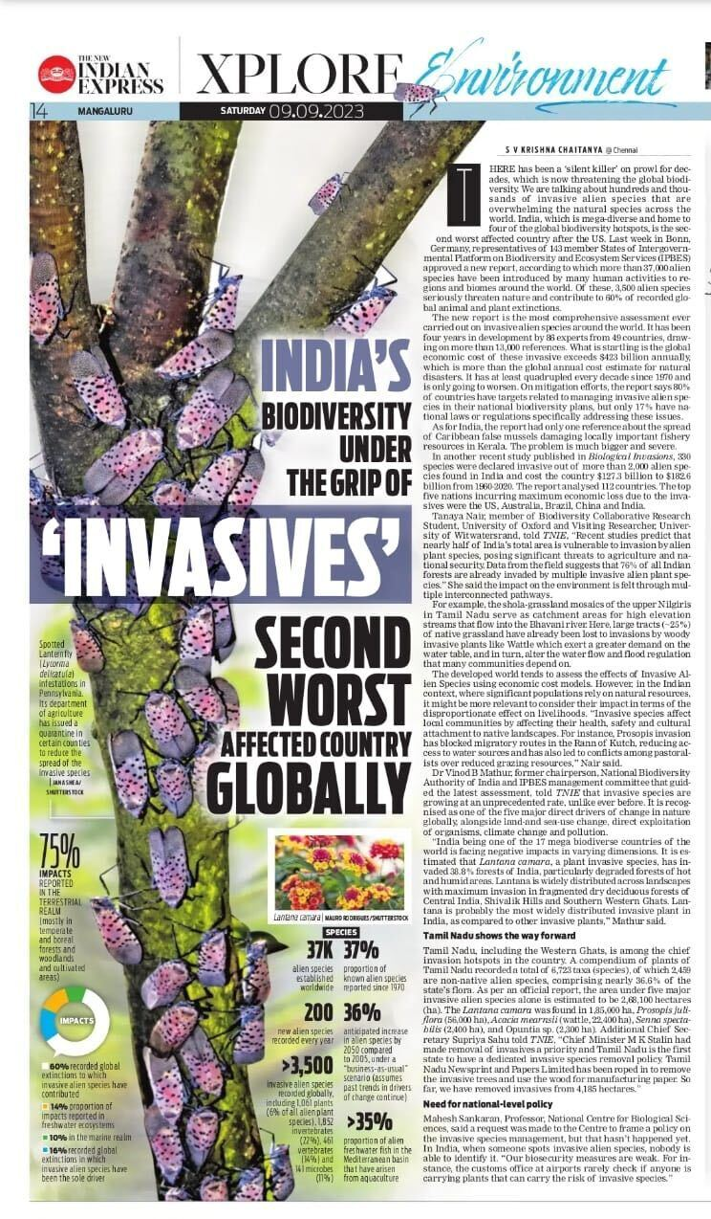
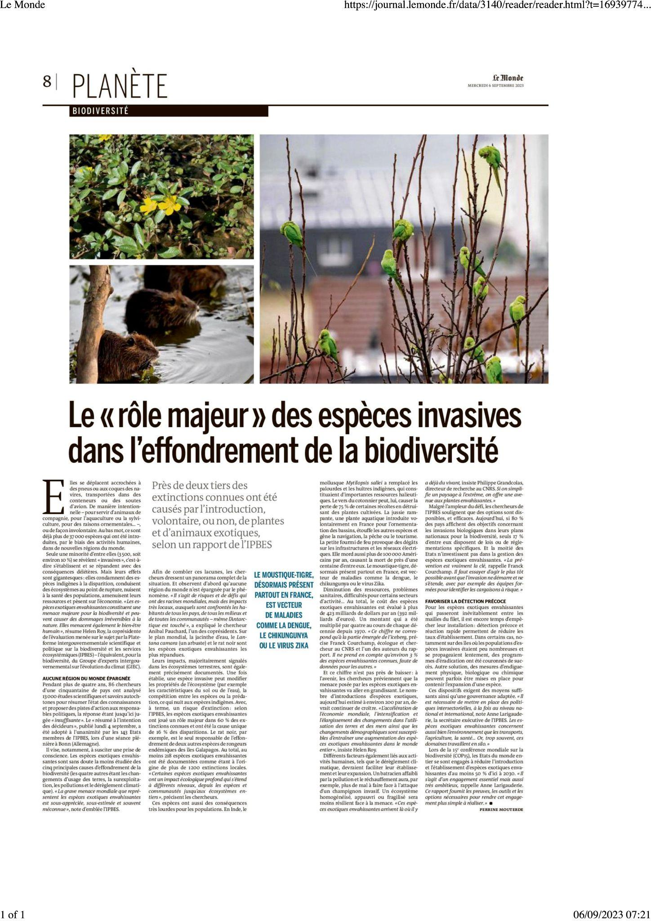
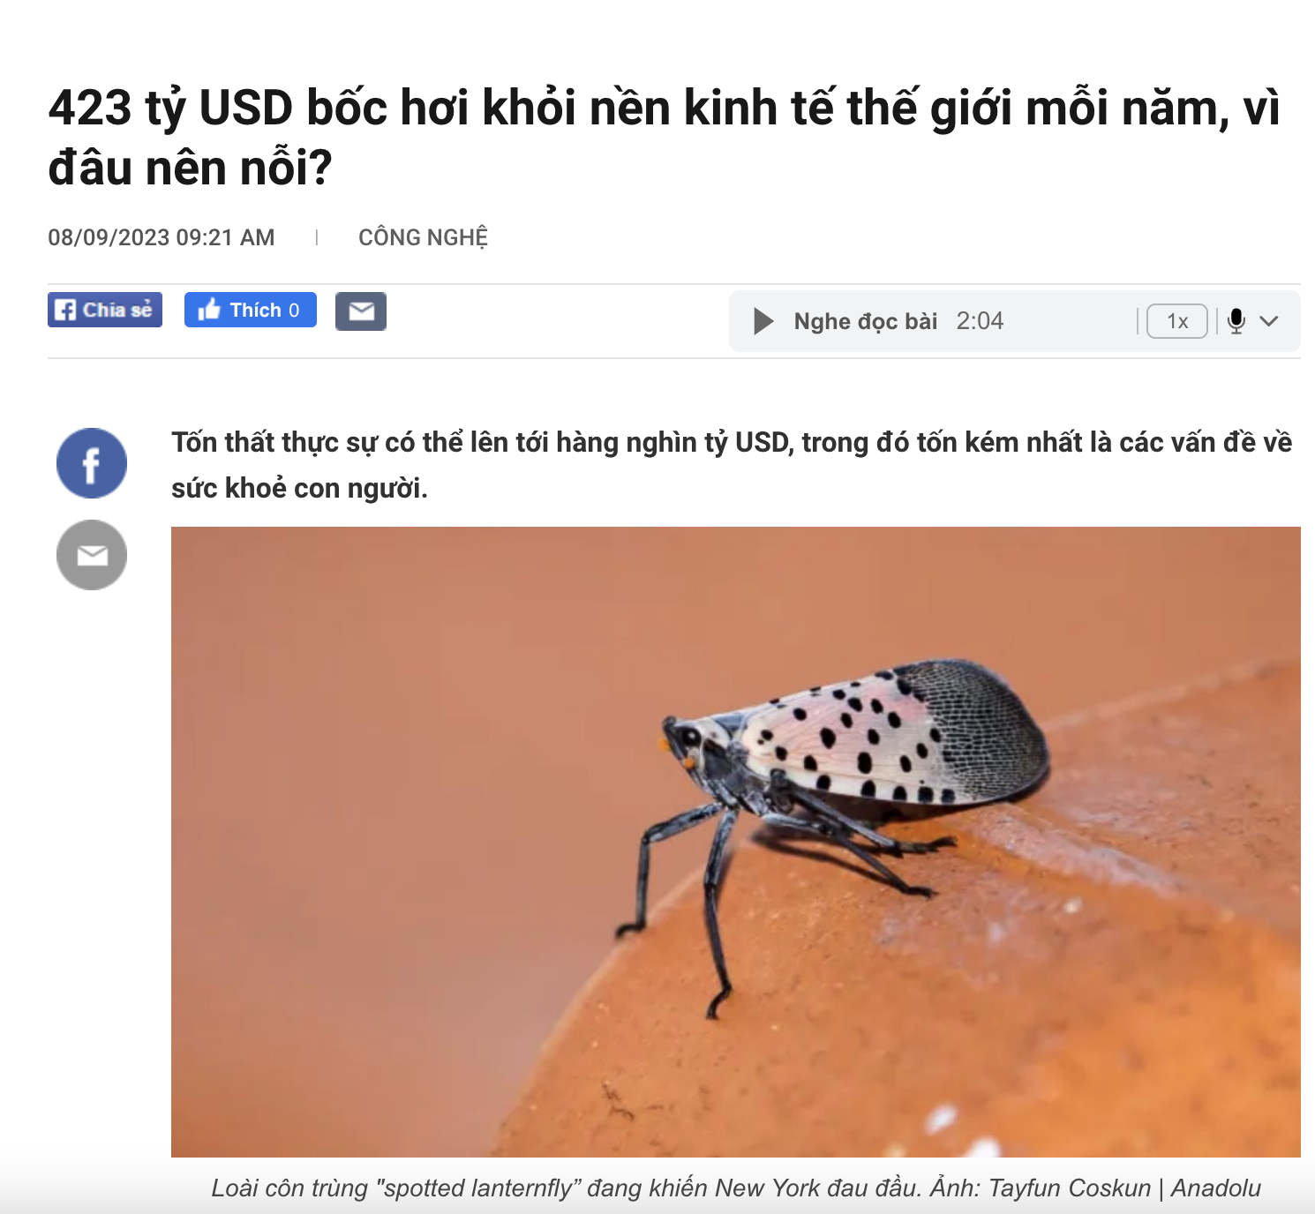
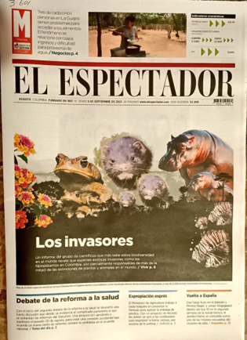
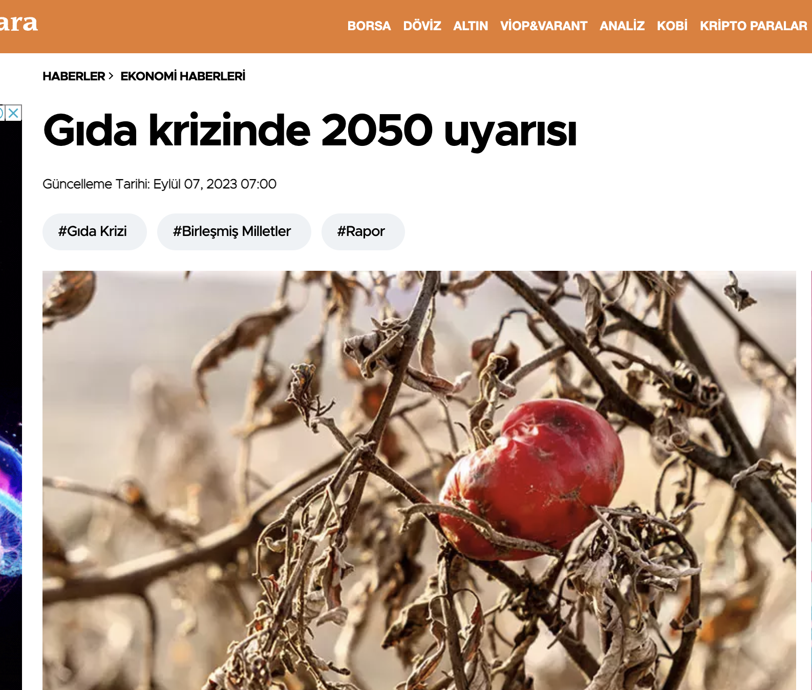
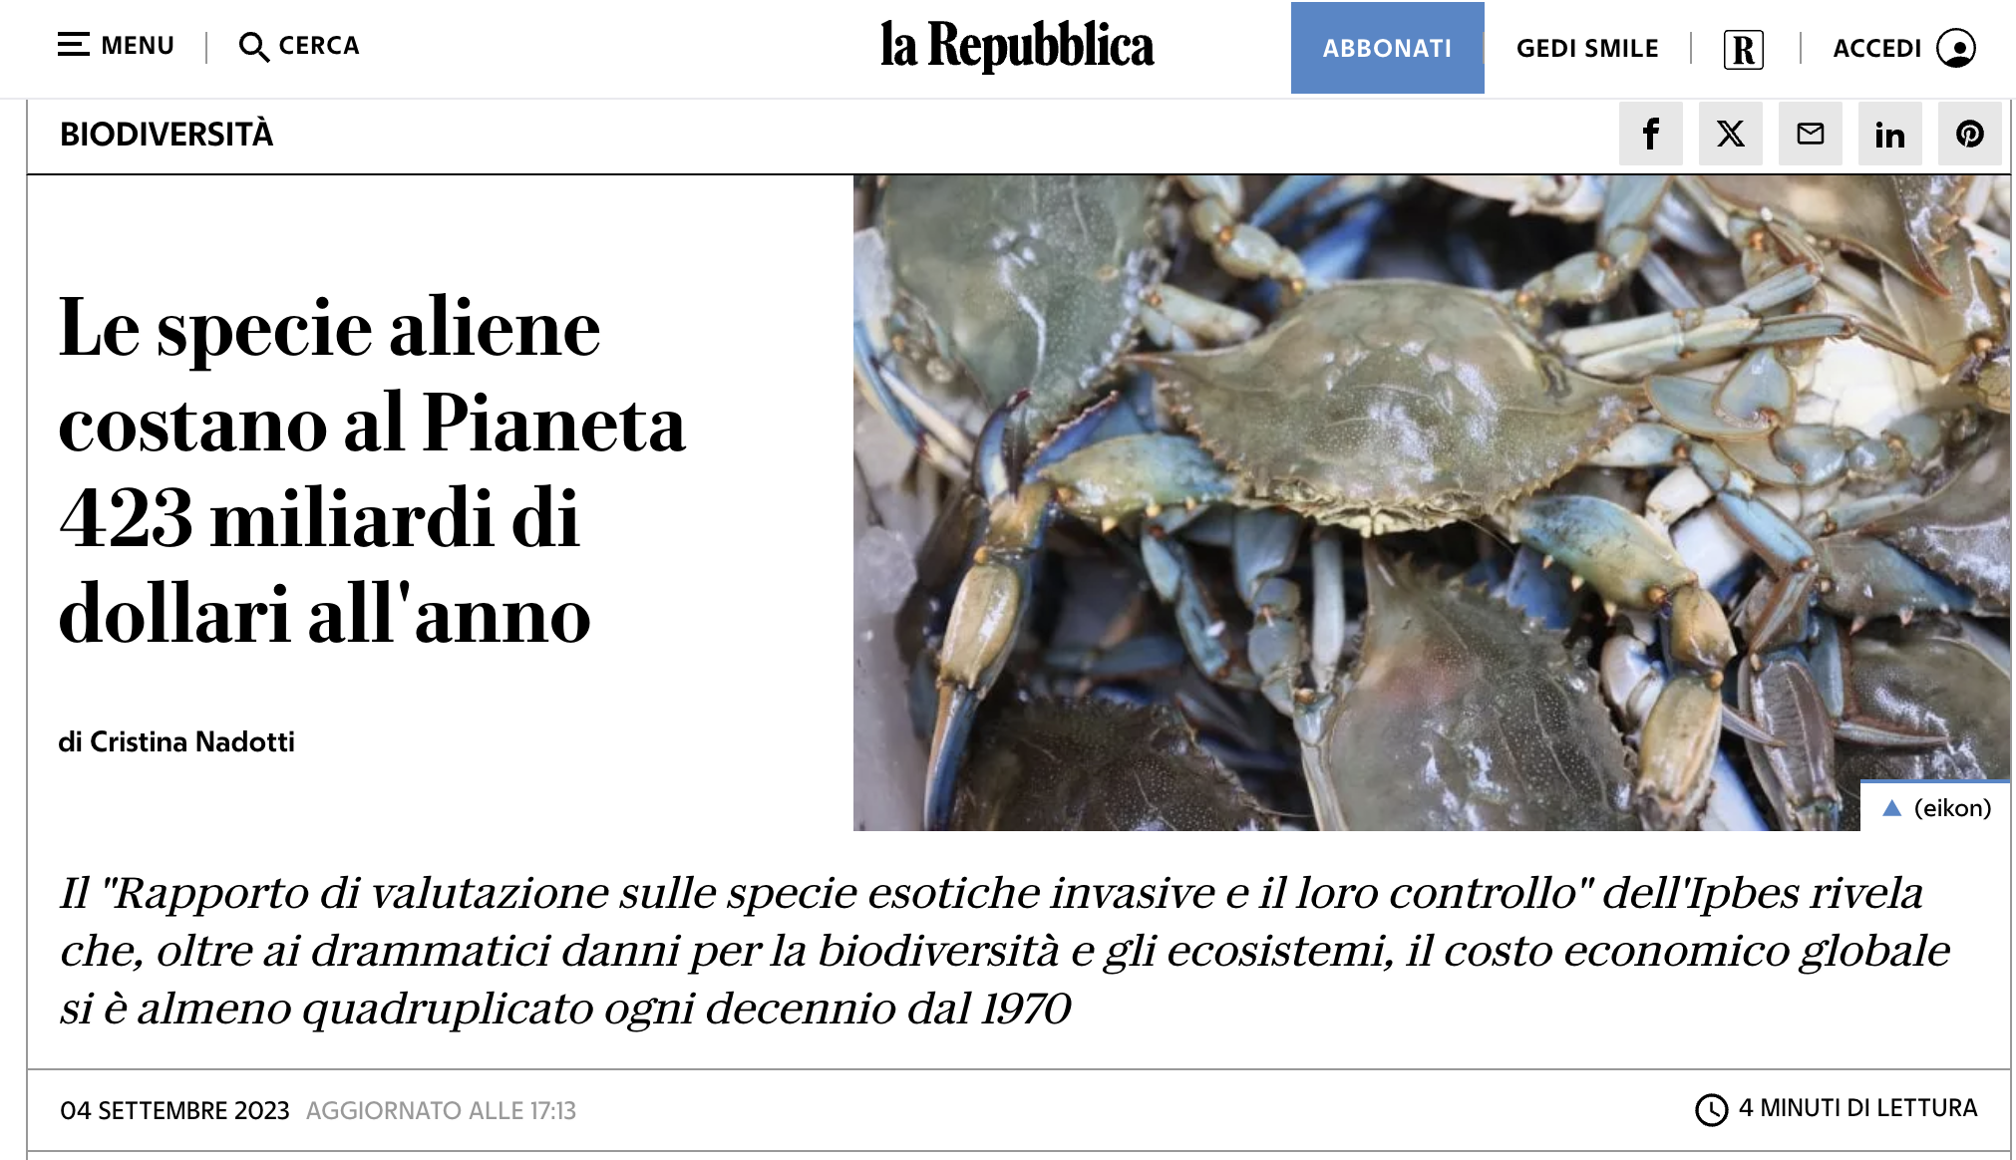
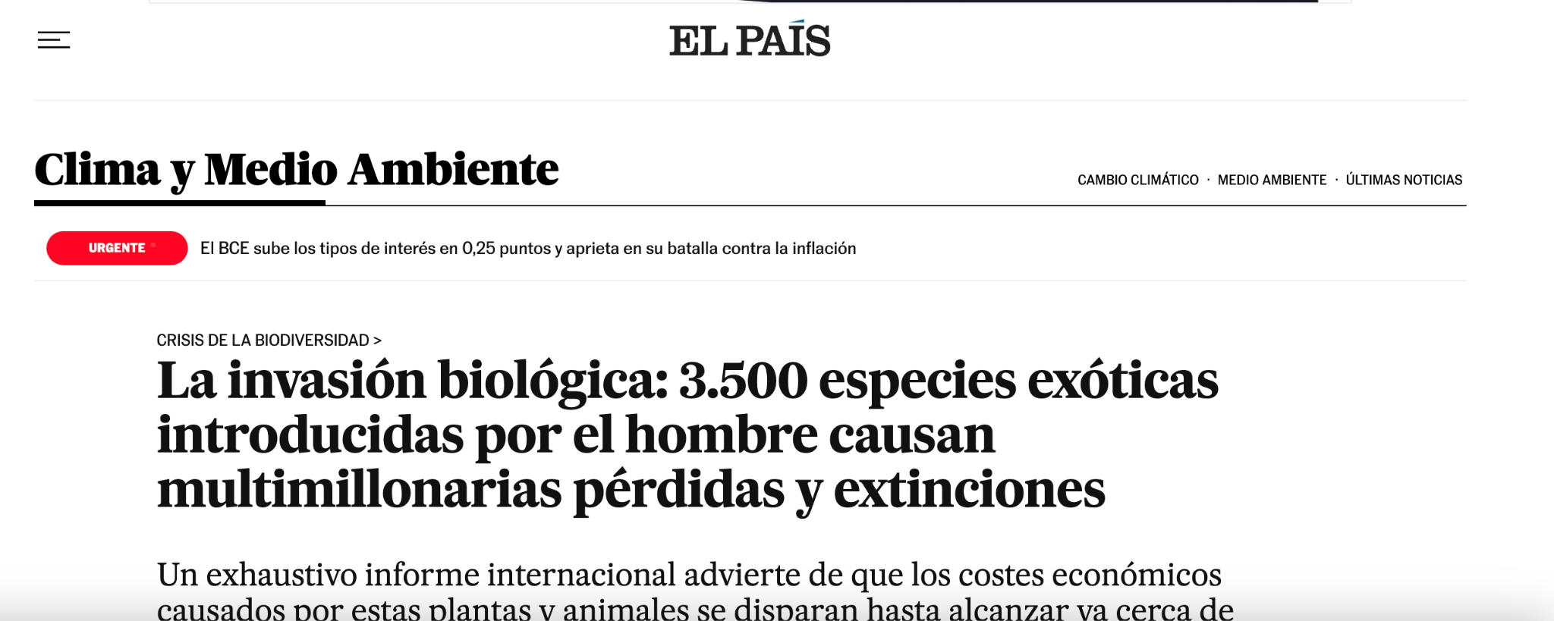
The invasive alien species Report will contribute to raising awareness on the issue of biological invasions
#InvasiveAlienSpecies Assessment
Media articles in ~ 50 languages in over 100 countries

Slide 35
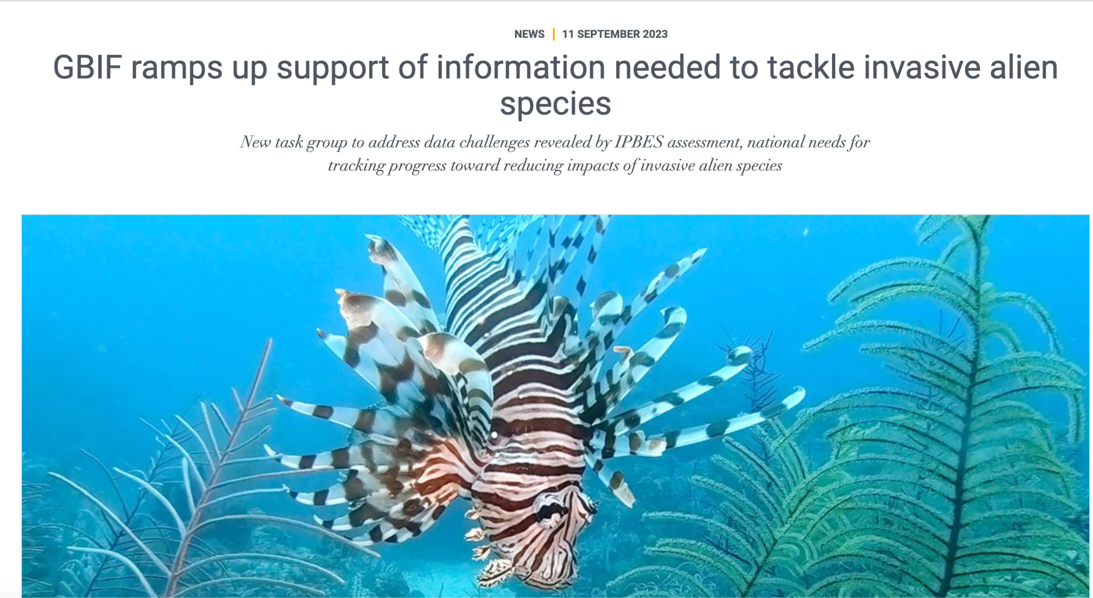
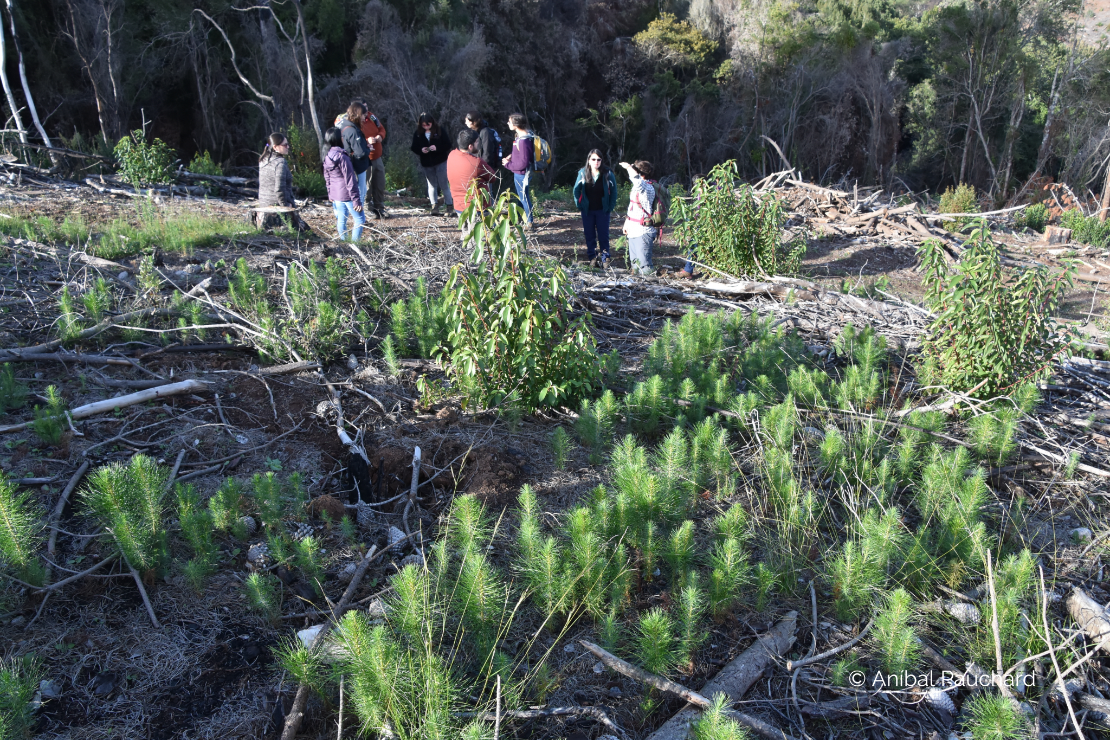
The invasive alien species Report will support sharing of information within and across countries
The Report will also support capacity building globally, especially in developing countries
Photo by IISD/ENB
#InvasiveAlienSpecies Assessment

Slide 36

The findings of the invasive alien species assessment are expected to contribute to achieving international targets on biological invasions:
- Target 6 of the Kunming-Montreal Global Biodiversity Framework
- Support implementation of the Sustainable Development Goals of the 2030 Agenda for Sustainable Development, especially Goal 15
Photo by IISD/ENB
#InvasiveAlienSpecies Assessment

Slide 37
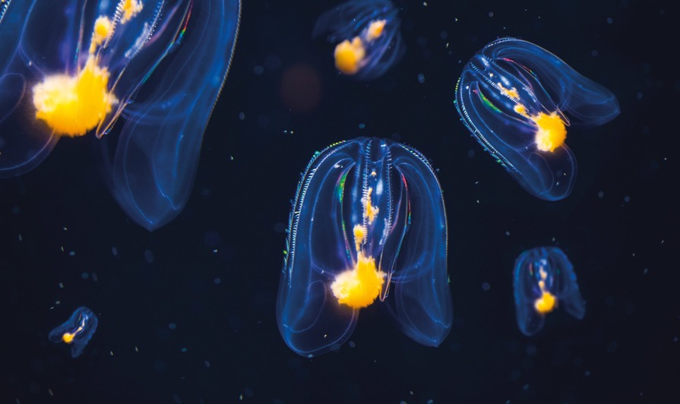
Assessment process
4.

Slide 38
Developed over 4 years
3 Authors meetings (Tsukuba, online & Aarhus)
2 External reviews
1 Additional review by governments
Produced by a multidisciplinary team of 86 experts and many contributing authors
Over 13,000 documents reviewed in depth
Various values and knowledge systems considered, drawing on scientific and grey literature, and information from indigenous and local knowledge
Engagement with Indigenous and local knowledge
3 dialogue workshops (Montreal and online),
a call for contributions, and
collaboration with ILK experts and holders within the expert team and as contributing authors
#InvasiveAlienSpecies Assessment

Slide 39
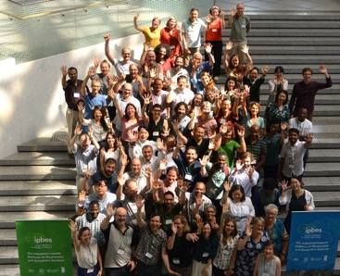
Produced by a multidisciplinary team of 86 experts and many contributing authors
86 nominated experts from 47 countries, encompassing all regions and many disciplines
About 200 contributing authors
Supported by a management committee
Technical support unit based in Japan (Institute for Global Environmental Strategies, IGES)
#InvasiveAlienSpecies Assessment

Slide 40
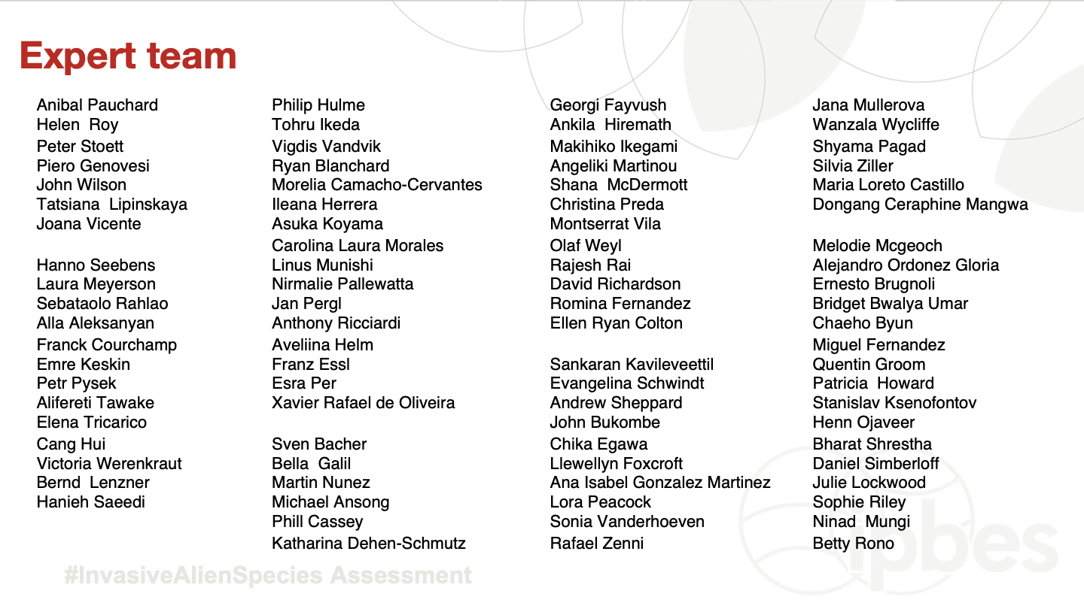
#InvasiveAlienSpecies Assessment

Slide 41

Thank you!
¡Gracias!
Merci!
#InvasiveAlienSpecies Assessment

